Slide 1
Java Programming Unit IV – Chapter 17 Collections Framework

Slide 2
Contents
Overview
Collection Interfaces
Collection Classes
Iterator
Comparators
Collection Algorithms
Legacy classes and Interfaces

Slide 3
1. Overview
The java.util package also contains one of Java’s most powerful subsystems: The Collections Framework.
The Collections Framework is a sophisticated hierarchy of interfaces and classes
Provides state-of-the-art technology for managing groups of objects

Slide 4
Collections Framework
Standardizes the way in which groups of objects are handled
Only added in J2SE 1.2
Advantages:
High-performance and highly efficient
High degree of interoperability
Easy Extendability

Slide 5
Collection Algorithms
Algorithms operate on collections and are defined as static methods within the Collections class
The algorithms provide a standard means of manipulating collections

Slide 6
Iterator Interface
An iterator offers a general-purpose, standardized way of accessing the elements within a collection, one at a time
It provides a means of enumerating the contents of a collection
Map Interfaces and Classes
Maps store key/value pairs.

Slide 7
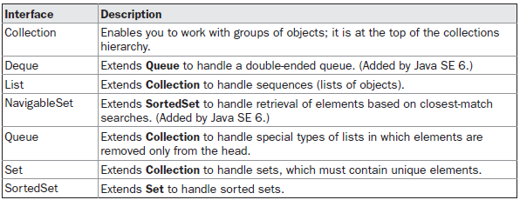
2. The Collection Interface
The following are the interfaces in Collection:
Other Interfaces: Comparator, RandomAccess, Iterator, and ListIterator

Slide 8
Two types of Collections
Modifiable
Collections, that support methods that enable to modify the contents of a collection
Un-modifiable
Collections that do not allow their contents to be changed are called unmodifiable

Slide 9
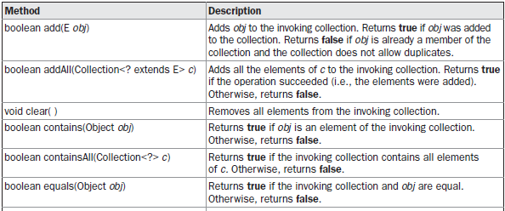
a) Collection Interface
Declaration: interface Collection <E>
E specifies the type of objects that the collection will hold

Slide 10
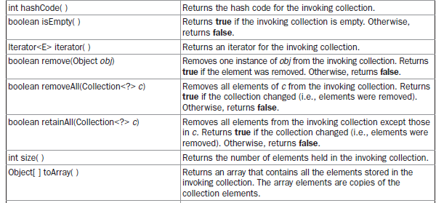
a) Collection Interface ...

Slide 11
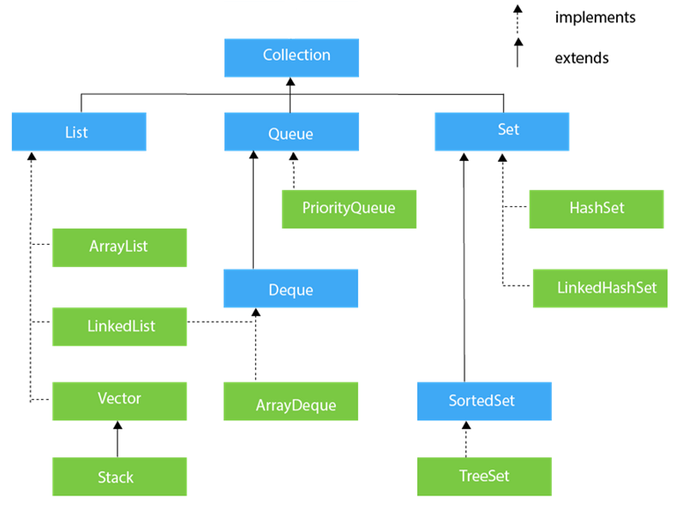

Slide 12
b) The List Interface
The List interface extends Collection
Elements can be inserted or accessed by their position in the list
A list may contain duplicate elements
Declaration: interface List<E>
E specifies the type of objects that the list will hold
In addition to Collection, List provides its own methods

Slide 13
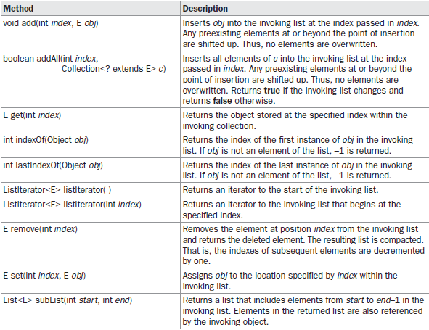

Slide 14
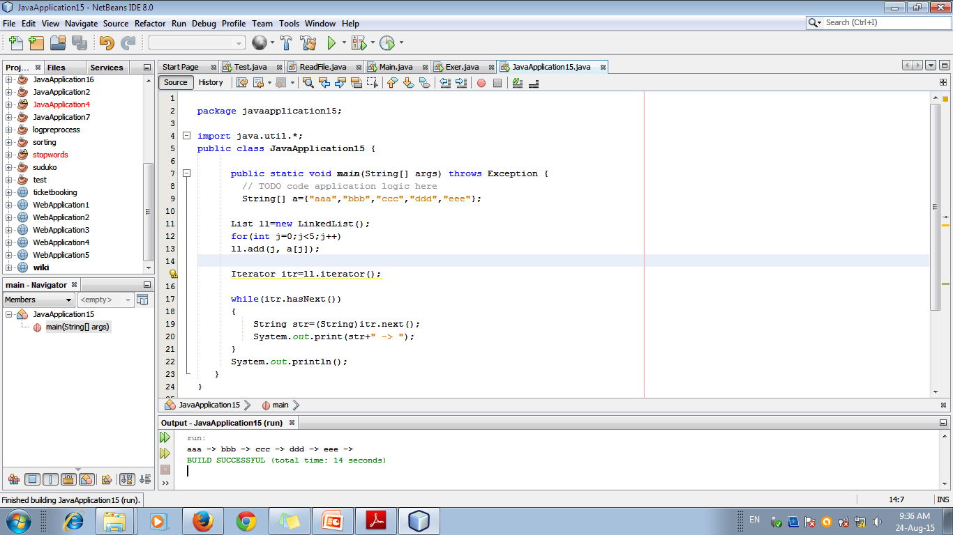

Slide 15
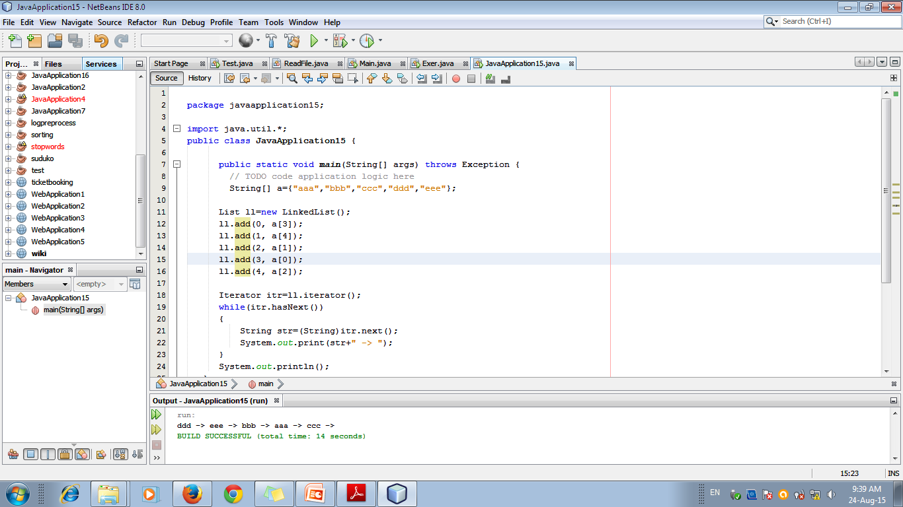

Slide 16
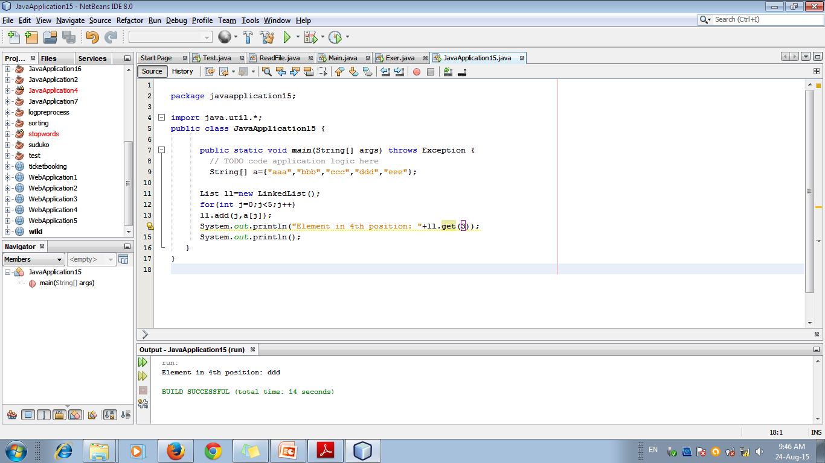

Slide 17
c) Set Interface
The Set interface defines a set.
It extends Collection and does not allow duplicate elements
It does not define any additional methods of its own
Declaration: interface Set<E>

Slide 18
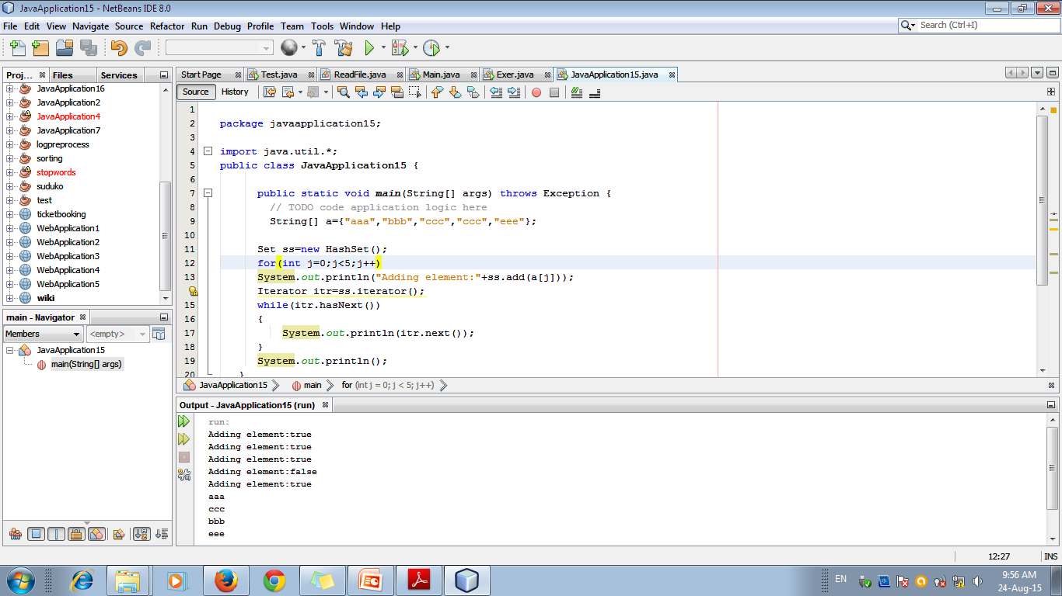

Slide 19
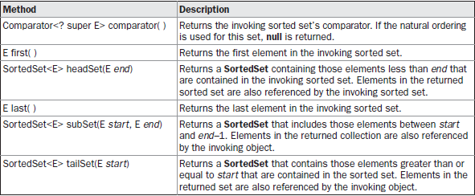
d) SortedSet Interface
The SortedSet interface extends Set
Adds the set elements sorted in ascending order

Slide 20
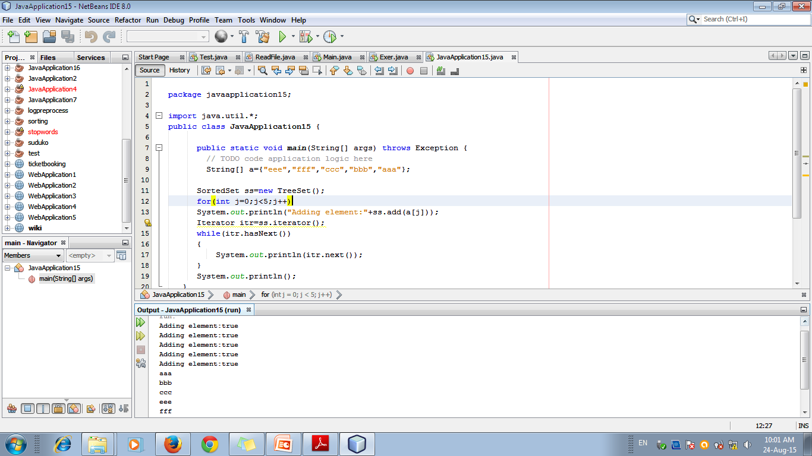

Slide 21
e) The NavigableSet Interface
The NavigableSet interface was added by Java SE6.
Supports the retrieval of elements based on the closest match to a given value or values

Slide 22
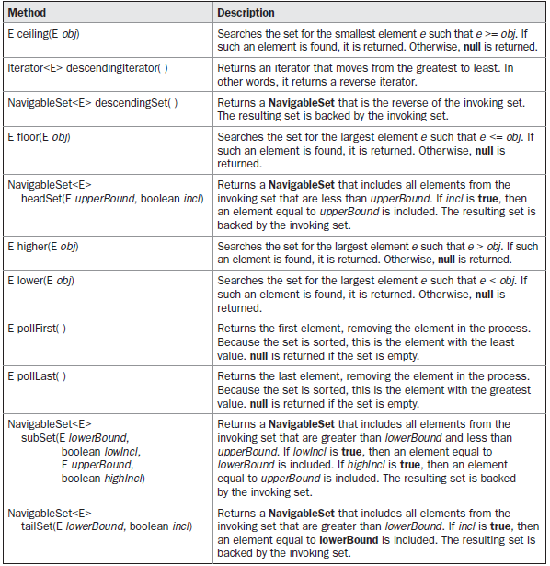

Slide 23
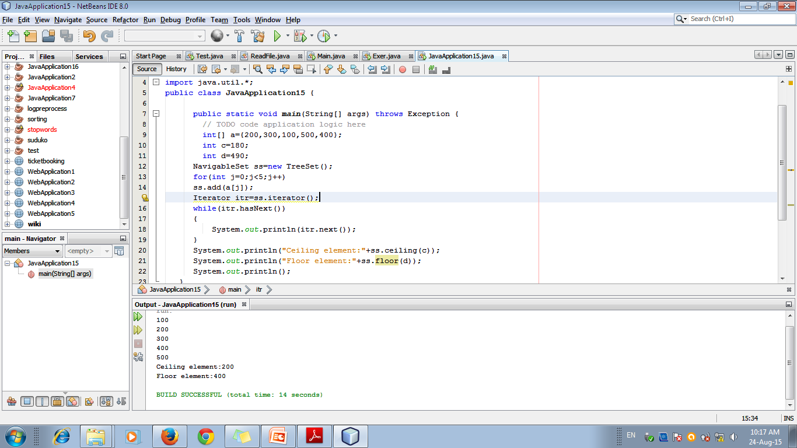

Slide 24
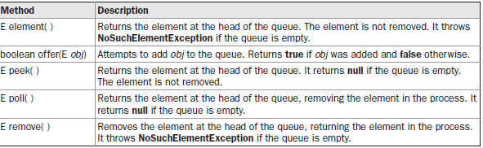
f) The Queue Interface
The Queue interface extends Collection
Behaves like first-in, first-out list

Slide 25
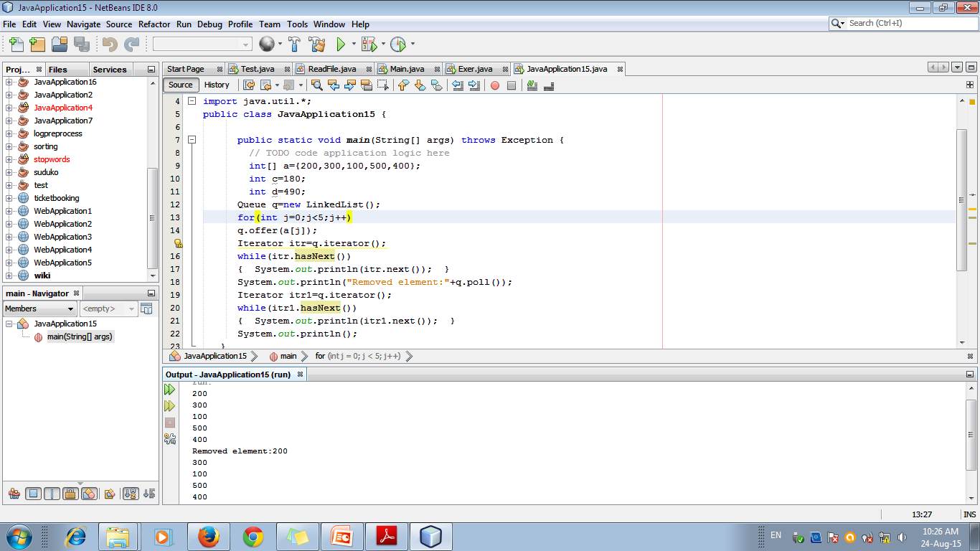

Slide 26
g) The Deque Interface
It extends Queue and behaves like double-ended Queue
Double-ended queues can function as standard, first-in, first-out queues or as last-in, first-out stacks

Slide 27
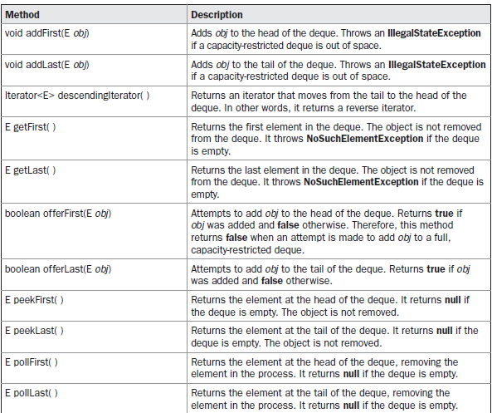

Slide 28
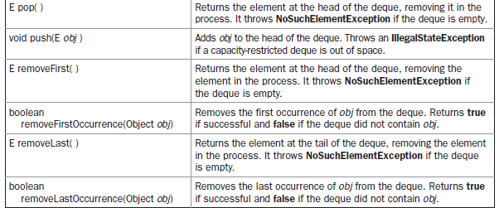

Slide 29
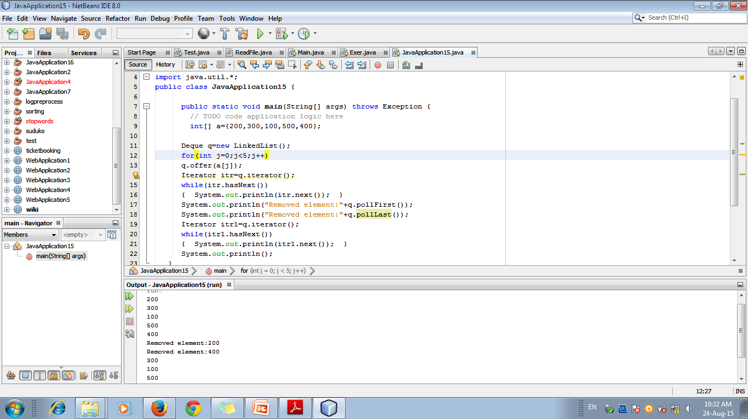

Slide 30
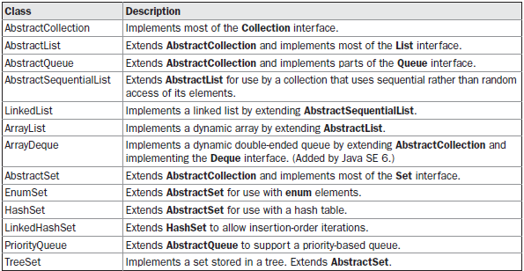
3) The Collection Classes

Slide 31
a) The ArrayList Class
ArrayList supports dynamic arrays that can grow as needed.
In Java, standard arrays are of a fixed length
must know in advance how many elements an array will hold
ArrayList is a variable-length array of object references.
It can dynamically increase or decrease in size.

Slide 32
ArrayList Constructors
ArrayList( )
builds an empty array list
ArrayList(Collection<? extends E> c)
builds an array list that is initialized with the elements of the collection c.
ArrayList(int capacity)
builds an array list that has the specified initial capacity

Slide 33
Other Functions
void ensureCapacity(int cap)
Used to increase the capacity of an ArrayList object manually
void trimToSize( )
Used to reduce the size of the array to the number of elements present.

Slide 34
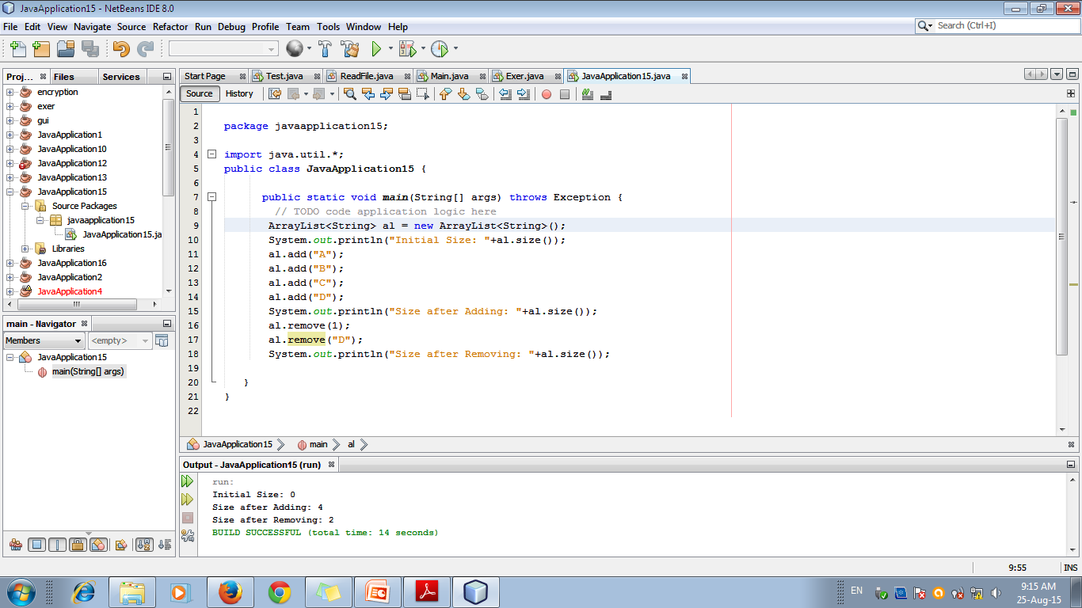

Slide 35
b) LinkedList Class
The LinkedList class extends AbstractSequentialList and implements the List, Deque, and Queue interfaces.
2 Constructors:
LinkedList( )
builds an empty linked list
LinkedList(Collection<? extends E> c)
builds a linked list that is initialized with the elements of the collection c

Slide 36
c) HashSet Class
HashSet extends AbstractSet and implements the Set interface.
It creates a collection that uses a hash table for storage.
A hash table stores information by using a mechanism called hashing.
In hashing, the informational content of a key is used to determine a unique value, called its hash code.
The hash code is then used as the index at which the data associated with the key is stored.

Slide 37
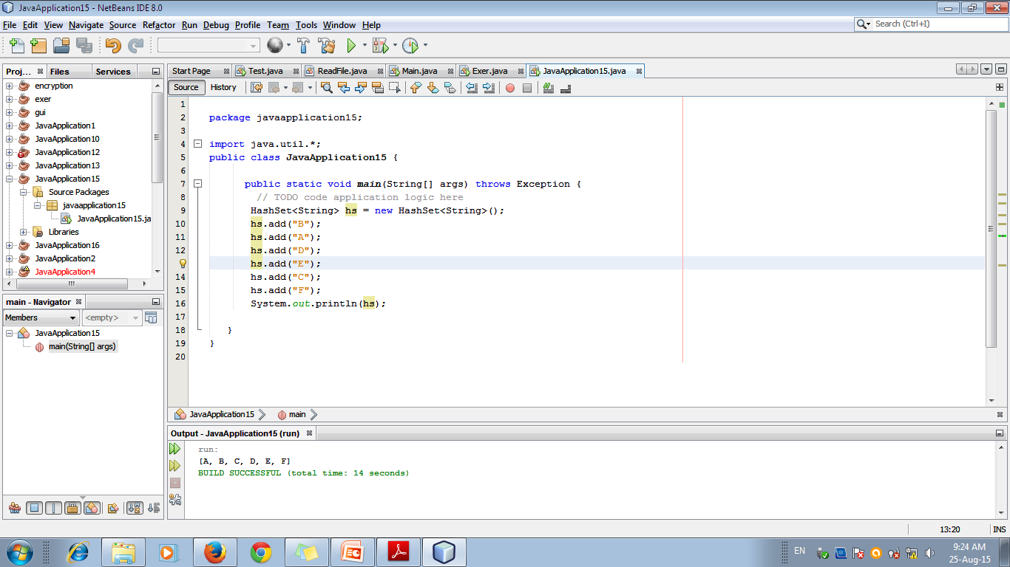

Slide 38
d) The LinkedHashSet Class
LinkedHashSet maintains a linked list of the entries in the set, in the order in which they were inserted.
This allows insertion-order iteration over the set
i.e.., when using an iterator, the elements will be returned in the order in which they were inserted

Slide 39
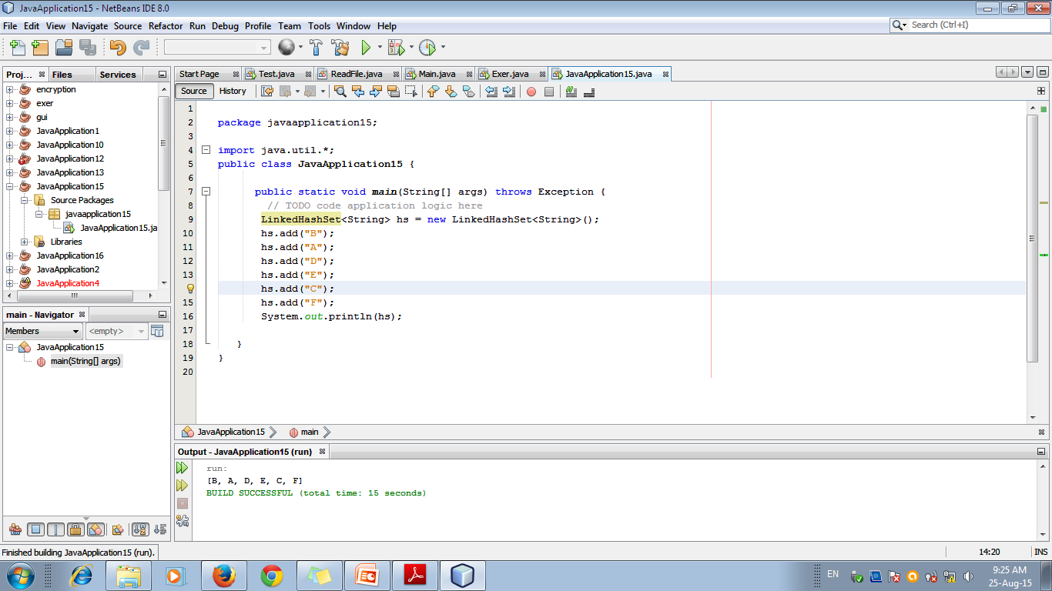

Slide 40
e) The TreeSet Class
TreeSet extends AbstractSet and implements the NavigableSet interface
It creates a collection that uses a tree for storage
But, Items are sorted automatically
Constructors:
TreeSet( )
TreeSet(Collection<? extends E> c)
TreeSet(Comparator<? super E> comp)
TreeSet(SortedSet<E> ss)

Slide 41
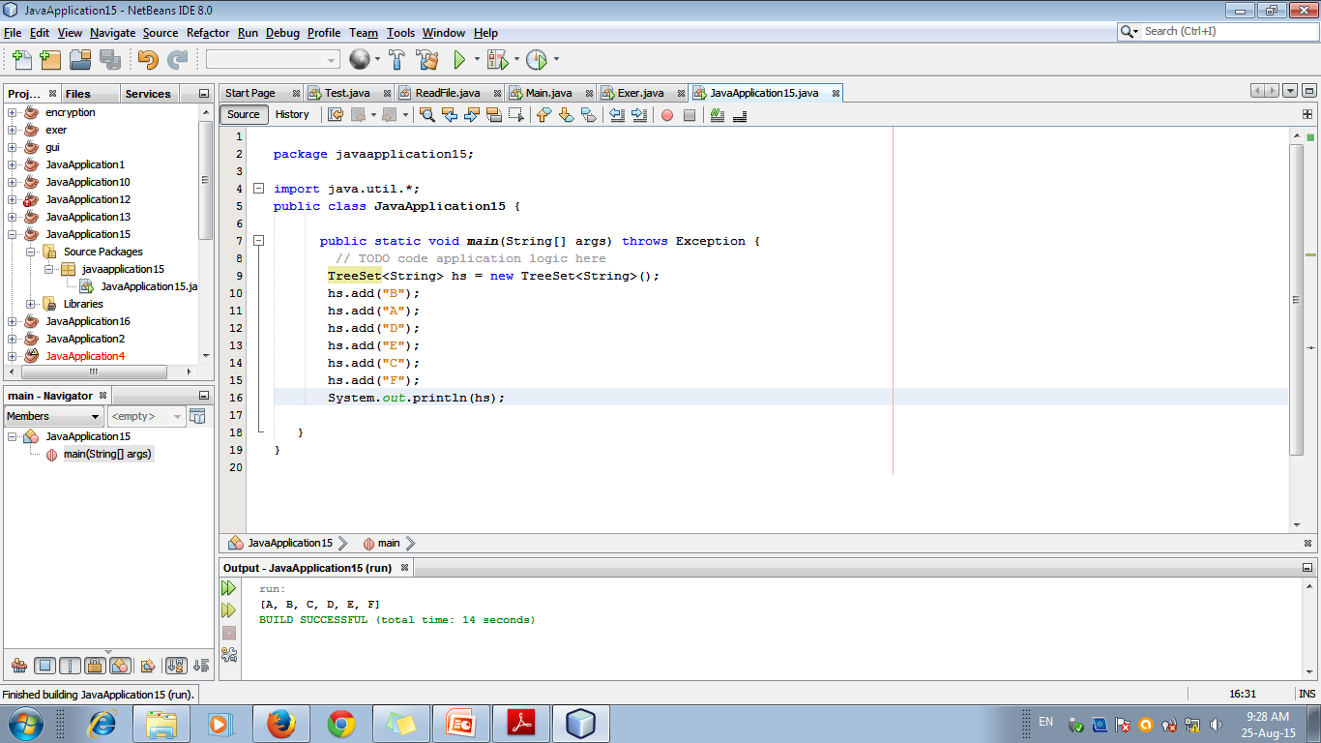

Slide 42
f) The PriorityQueue Class
PriorityQueue extends AbstractQueue and implements the Queue interface.
It creates a queue that is prioritized based on the queue’s comparator
Elements can be inserted in any order but removal of the elements is in a sorted order
Constructors:
PriorityQueue( ) – Creates an empty queue with initial size=11
PriorityQueue(int capacity)
PriorityQueue(int capacity, Comparator<? super E> comp)
PriorityQueue(Collection<? extends E> c)

Slide 43
g) The ArrayDeque Class
ArrayDeque creates a dynamic array and has no capacity restrictions.
Constructors:
ArrayDeque( )
ArrayDeque(int size)
ArrayDeque(Collection<? extends E> c)

Slide 44
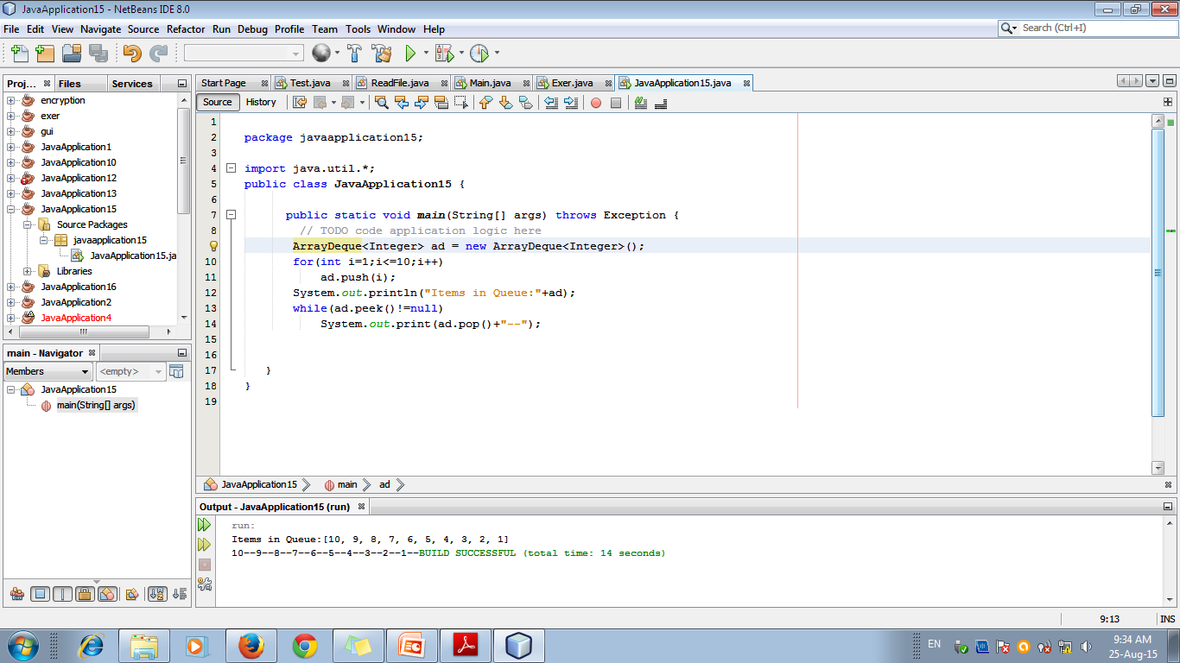

Slide 45
h) The EnumSet Class
EnumSet extends AbstractSet and implements Set.
It is specifically for use with keys of an enum type
EnumSet defines no constructors

Slide 46
4) Using Iterator
Used to cycle through the elements in a collection for obtaining or removing elements
Use either
Iterator
ListIterator - extends Iterator and allows bidirectional traversal of a list

Slide 47
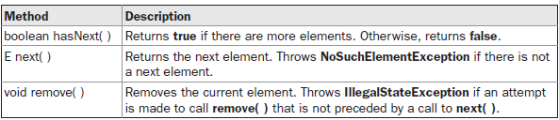
Methods in Iterator

Slide 48
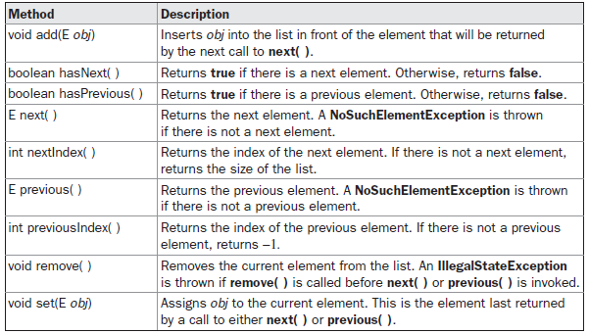
Methods in ListIterator

Slide 49
Accessing elements in Collection
3 Step Process:
1. Obtain an iterator to the start of the collection by calling the collection’s iterator( ) method.
2. Set up a loop that makes a call to hasNext( ). Have the loop iterate as long as hasNext( ) returns true.
3. Within the loop, obtain each element by calling next( ).
1
2
3

Slide 50
Tutorial
Write a program that creates String ArrayList and adds 5 elements.
Display using iterator.
Now change each element in the list.
Again display the elements in reverse order.

Slide 51
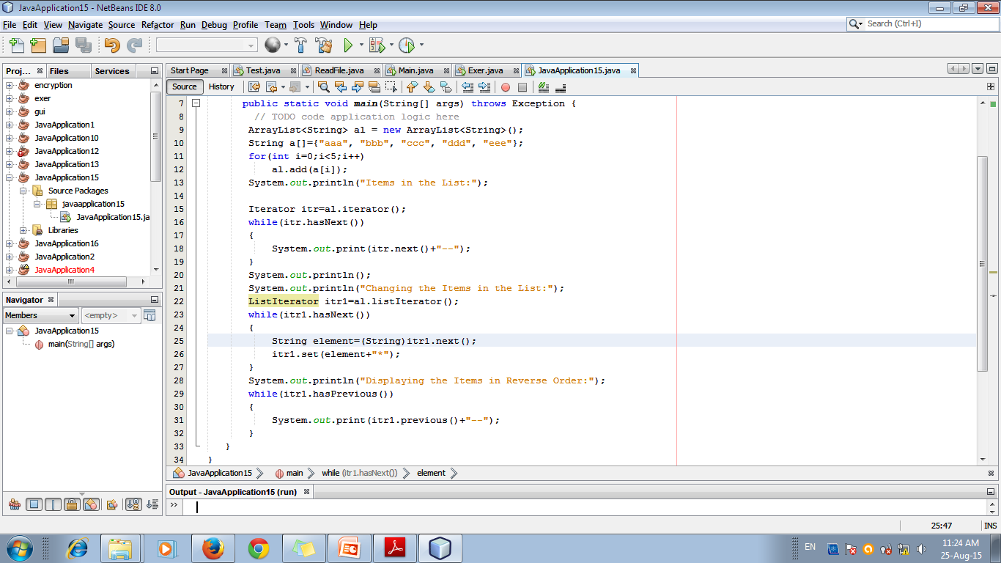

Slide 52
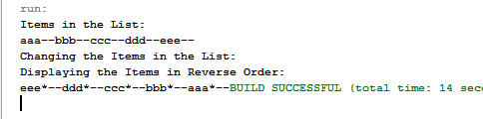

Slide 53
User Defined Collections
Collections are not limited to the storage of built-in objects.
The following example creates a new Linked List of “Student” datatype

Slide 54
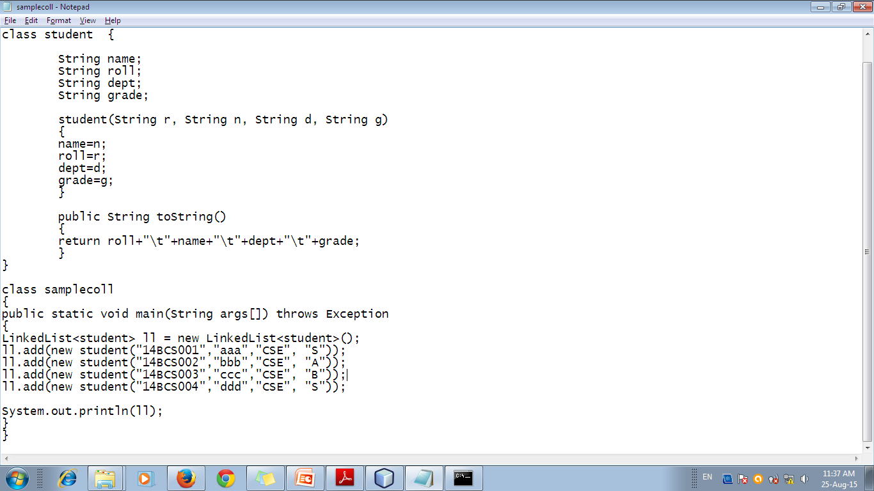

Slide 55
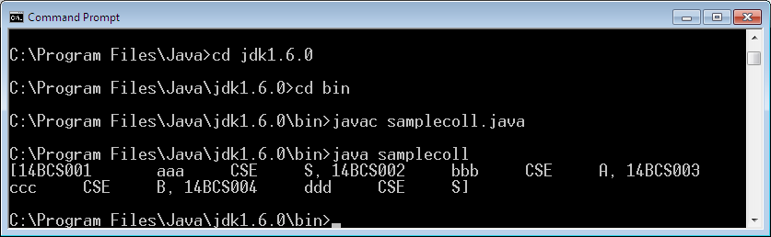

Slide 56
Random Access Interface
Supports efficient random access to the collection elements
RandomAccess is implemented by ArrayList and by the legacy Vector class, among others.

Slide 57
5) Working with Maps
A map is an object that stores associations between keys and values, or key/value pairs.
Given a key, you can find its value.
Both keys and values are objects.
The keys must be unique, but the values may be duplicated.
Some maps can accept a null key and null values, others cannot.
Maps does not implement the Iterable interface

Slide 58
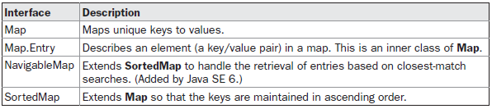
The Map Interfaces

Slide 59
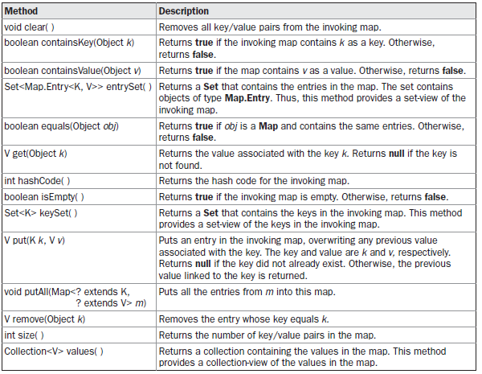
a) Map Interface

Slide 60
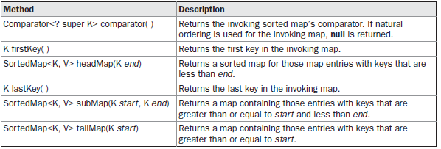
b) The SortedMap Interface
The SortedMap interface extends Map.
It ensures that the entries are maintained in ascending order based on the keys.

Slide 61
3) The NavigableMap Interface
It extends SortedMap and declares the behavior of a map that supports the retrieval of entries based on the closest match to a given key or keys

Slide 62
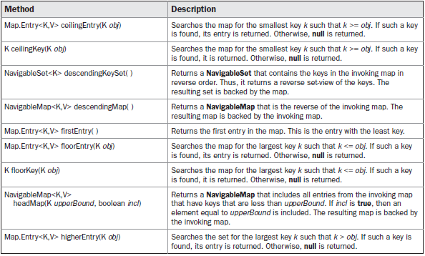
Functions …

Slide 63
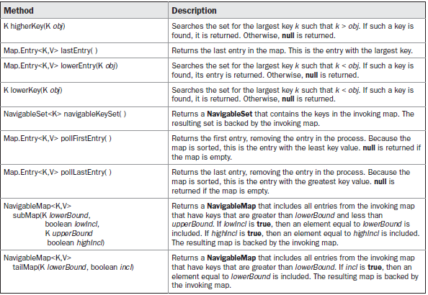
Functions…

Slide 64
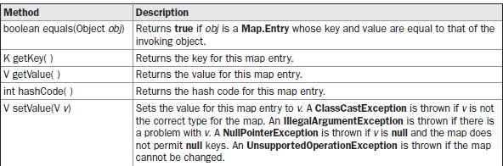
4) The Map.Entry Interface
Enables to work with a map entry

Slide 65
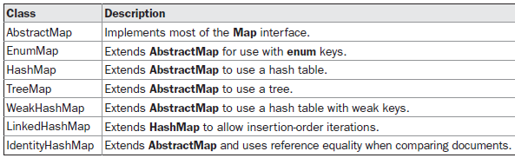
The Map Class
Used to provide implementation of Map interfaces

Slide 66
a) The HashMap Class
The HashMap class extends AbstractMap and implements the Map interface.
It uses a hash table to store the map.
Declaration: class HashMap<K, V>
Constructors:
HashMap( )
HashMap(Map<? extends K, ? extends V> m)
HashMap(int capacity)
HashMap(int capacity, float fillRatio)

Slide 67
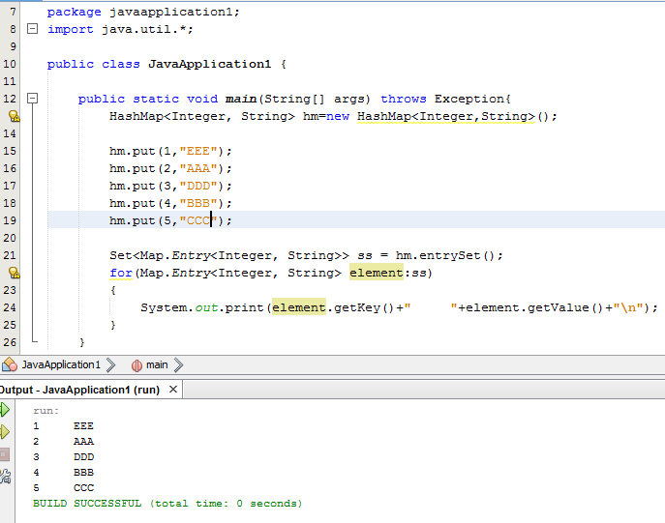

Slide 68
b) The TreeMap Class
The TreeMap class extends AbstractMap and implements the NavigableMap interface.
It creates maps stored in a tree structure.
A TreeMap provides an efficient means of storing key/value pairs in sorted order and allows rapid retrieval
A tree map guarantees that its elements will be sorted in ascending key order

Slide 69
Constructors:
TreeMap( )
TreeMap(Comparator<? super K> comp)
TreeMap(Map<? extends K, ? extends V> m)
TreeMap(SortedMap<K, ? extends V> sm)

Slide 70
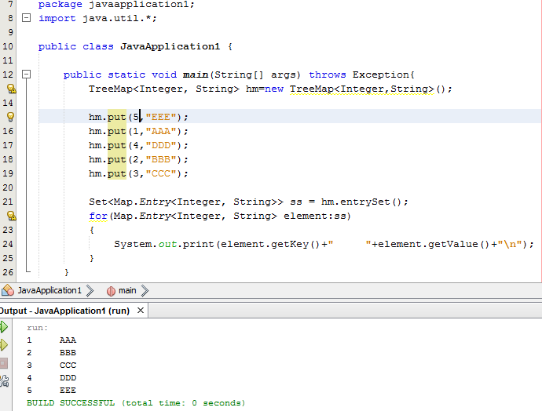

Slide 71
c) The LinkedHashMap Class
It maintains a linked list of the entries in the map, in the order in which they were inserted.
This allows insertion-order iteration over the map.
That is, when iterating through a collection-view of a LinkedHashMap, the elements will be returned in the order in which they were inserted

Slide 72
Constructors:
LinkedHashMap( )
LinkedHashMap(Map<? extends K, ? extends V> m)
LinkedHashMap(int capacity)
LinkedHashMap(int capacity, float fillRatio)
LinkedHashMap(int capacity, float fillRatio, boolean Order)

Slide 73
d) The IdentityHashMap Class
IdentityHashMap extends AbstractMap and implements the Map interface.
It is similar to HashMap except that it uses reference equality when comparing elements

Slide 74
e) The EnumMap Class
EnumMap extends AbstractMap and implements Map.
It is specifically for use with keys of an enum type

Slide 75
5) Comparator
SortedSet, TreeSet – Sorts the collection items based on “Natural Order”
If you want to order elements a different way, then specify a Comparator
2 methods:
compare(T obj1, T obj2) → compares 2 objects
=0 (if equal), Positive (if obj1>obj2) and Negative (if obj1<obj2)
obj1.equals(T obj2) → checks whether obj1=obj2 and returns true/false

Slide 76
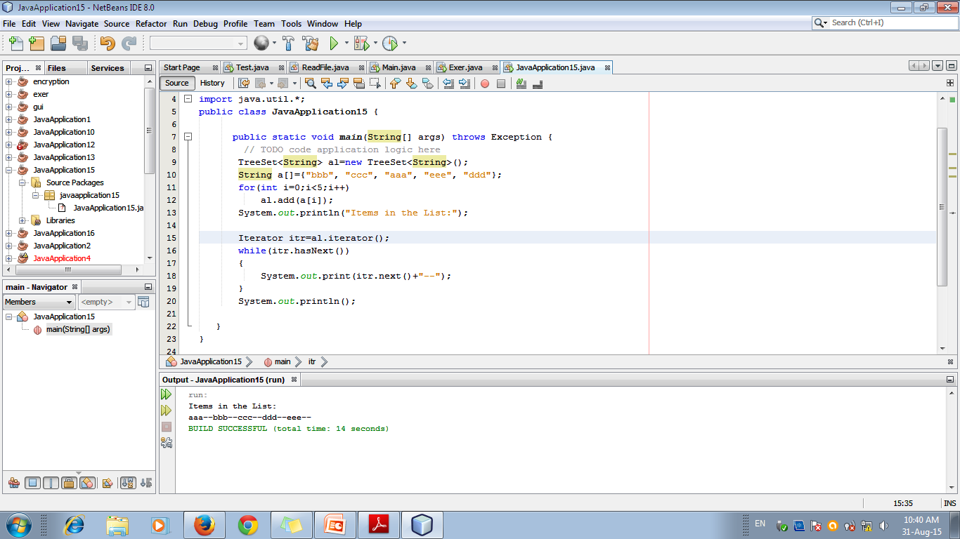
Using a Comparator

Slide 77
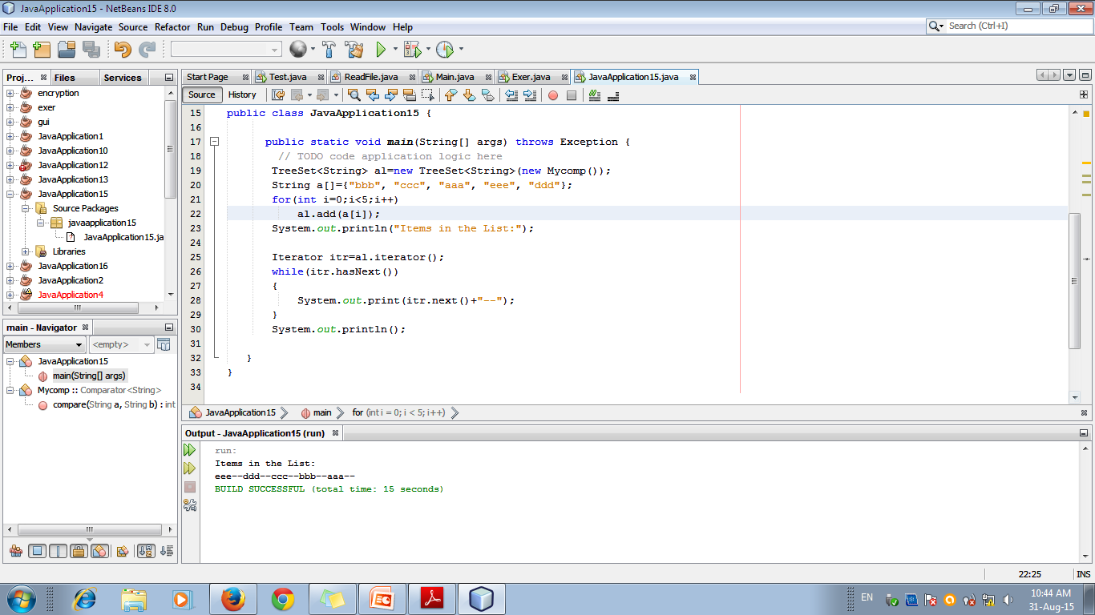

Slide 78
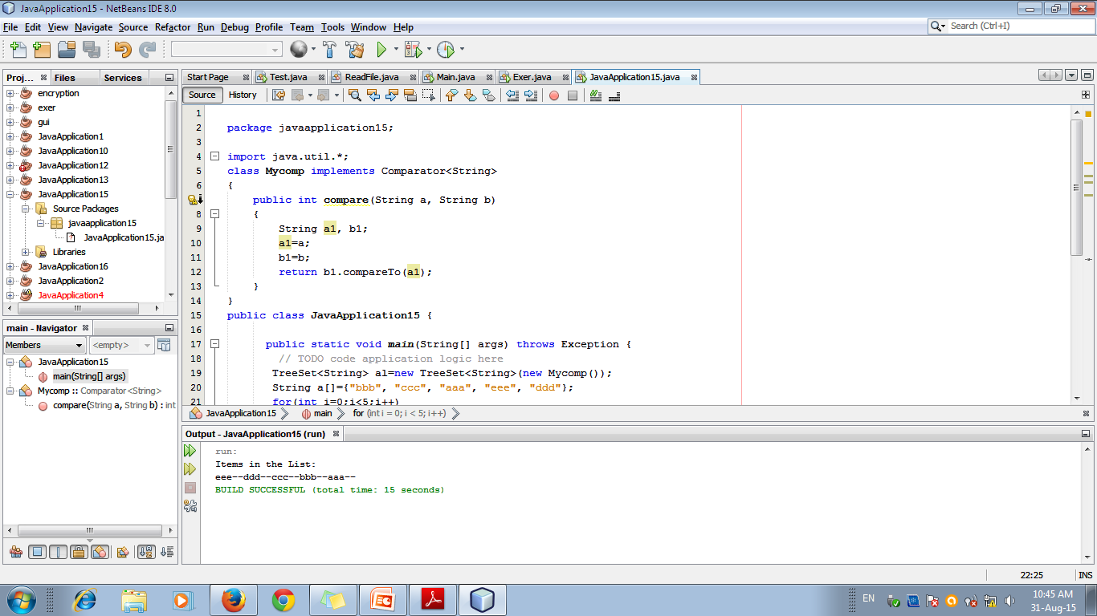

Slide 79
6) Legacy Classes and Interfaces
Used before Collections and Interfaces
Supports adhoc method of operating on a set of objects
Difference: none of the collection classes are synchronized, but all the legacy classes are synchronized.
Legacy classes:
Dictionary, HashTable, Properties, Stack & Vector

Slide 80
The Enumeration Interface
The Enumeration interface defines the methods by which you can enumerate (obtain one at a time) the elements in a collection of objects
This was replaced by “Iterator”
Declaration: interface Enumeration<E>
2 methods:
Boolean hasMoreElements()
E nextElement()

Slide 81
a) Vector
Vector implements a dynamic array.
It is similar to ArrayList. But:
Vector is synchronized,
It Contains many legacy methods that are not part of the Collections
Declaration: class Vector<E>
Constructors:
Vector( ) Vector(int size)
Vector(int size, int incr) Vector(Collection c)

Slide 82
3 data members in Vector
int capacityIncrement;
int elementCount;
Object[ ] elementData;

Slide 83
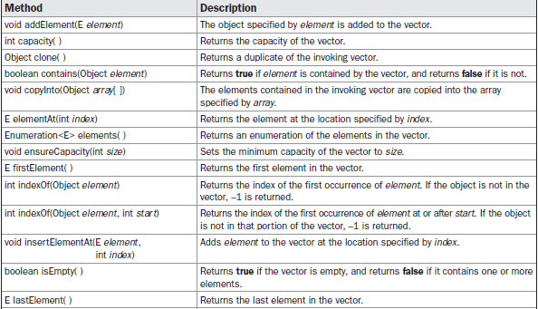

Slide 84
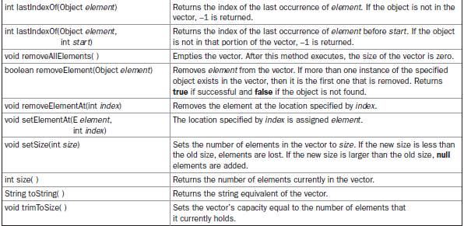

Slide 85
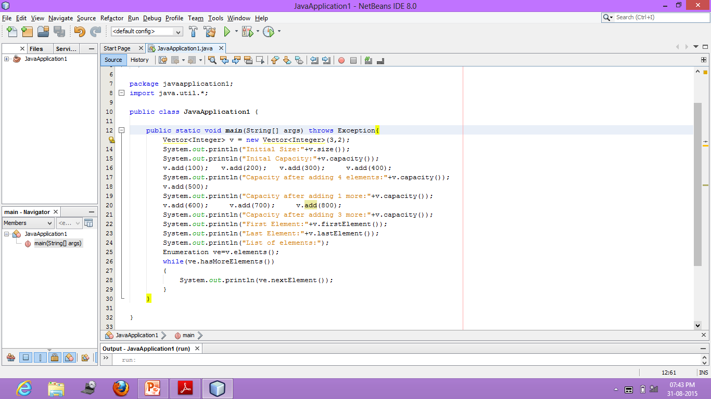

Slide 86
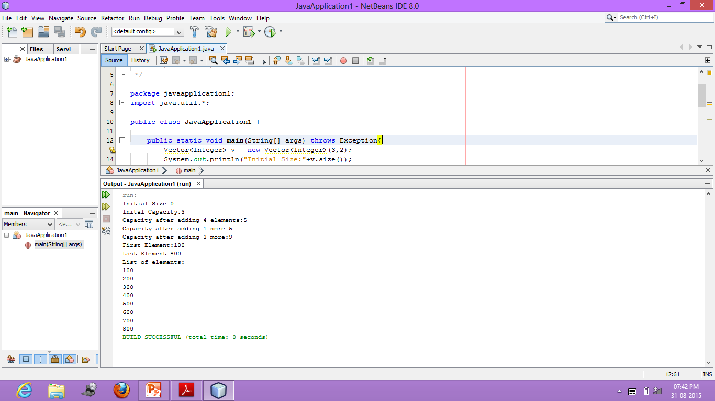

Slide 87
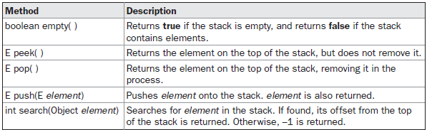
b) Stack
Stack is a subclass of Vector that implements a standard last-in, first-out stack.
Stack includes all the methods defined by Vector and adds several of its own

Slide 88
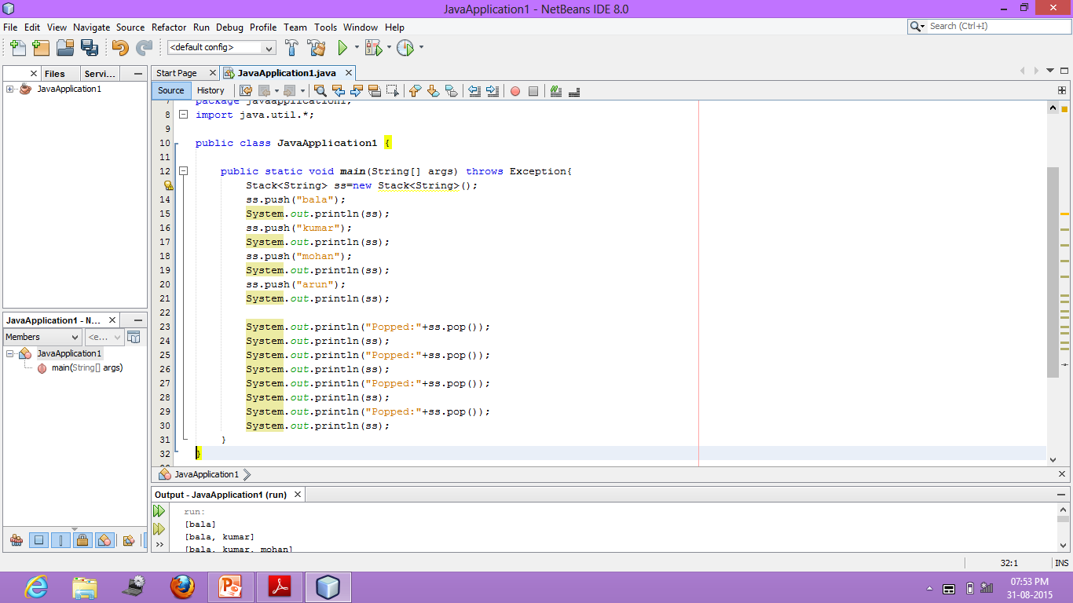

Slide 89
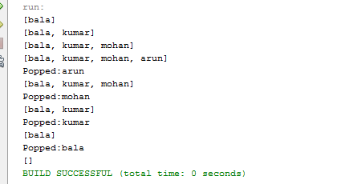

Slide 90
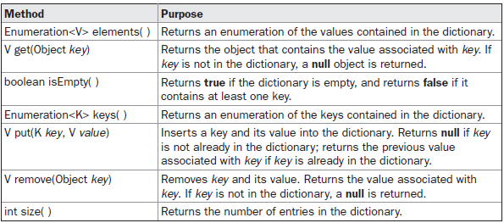
c) Dictionary
Dictionary is an abstract class that represents a key/value storage repository and operates much like Map.
Declaration class Dictionary<K,V>

Slide 91
d) HashTable
Similar to HashMap, but is synchronized
However, neither keys nor values can be null
Declaration: class Hashtable<K, V>
Constructors
Hashtable( )
Hashtable(int size)
Hashtable(int size, float fillRatio)
Hashtable(Map<? extends K, ? extends V> m)

Slide 92


Slide 93
e) Properties
Properties is a subclass of Hashtable.
It is used to maintain lists of values in which the key is a String and the value is also a String.
1 Instance Variable:
Properties defaults
2 Constructors:
Properties( )
Properties(Properties propDefault)

Slide 94


Slide 95


Slide 96
Using store() and load()
information contained in a Properties object can be easily stored to or loaded from disk with the store( ) and load( ) methods
Used for implementing simple databases

Slide 97

“stud.dat” in E: drive

Slide 98


Slide 99


Output

Slide 100
Tutorial:
Implement a simple telephone number database that stores names and phone numbers
To find a person’s number, you enter his or her name.
Allow the database to be updated by new entries
Use store( ) and load( ) methods to store and retrieve the list

Slide 101
7) Arrays
The Arrays class provides various methods that are useful when working with arrays
BinarySearch Method:
static int binarySearch(byte array[ ], byte value)
static int binarySearch(char array[ ], char value)
static int binarySearch(double array[ ], double value)
static int binarySearch(float array[ ], float value)
static int binarySearch(int array[ ], int value)
static int binarySearch(long array[ ], long value)
static int binarySearch(short array[ ], short value)
static int binarySearch(Object array[ ], Object value)
static <T> int binarySearch(T[ ] array, T value, Comparator<? super T> c)

Slide 102
Arrays…
copyOf() method:
static boolean[ ] copyOf(boolean[ ] source, int len)
static byte[ ] copyOf(byte[ ] source, int len)
static char[ ] copyOf(char[ ] source, int len)
static double[ ] copyOf(double[ ] source, int len)
static float[ ] copyOf(float[ ] source, int len)
static int[ ] copyOf(int[ ] source, int len)
static long[ ] copyOf(long[ ] source, int len)
static short[ ] copyOf(short[ ] source, int len)
static <T> T[ ] copyOf(T[ ] source, int len)
static <T,U> T[ ] copyOf(U[ ] source, int len, Class<? extends T[ ]> resultT)

Slide 103
Arrays…
copyOfRange( )
static boolean[ ] copyOfRange(boolean[ ] source, int start, int end)
static byte[ ] copyOfRange(byte[ ] source, int start, int end)
static char[ ] copyOfRange(char[ ] source, int start, int end)
static double[ ] copyOfRange(double[ ] source, int start, int end)
static float[ ] copyOfRange(float[ ] source, int start, int end)
static int[ ] copyOfRange(int[ ] source, int start, int end)
static long[ ] copyOfRange(long[ ] source, int start, int end)
static short[ ] copyOfRange(short[ ] source, int start, int end)
static <T> T[ ] copyOfRange(T[ ] source, int start, int end)
static <T,U> T[ ] copyOfRange(U[ ] source, int start, int end,
Class<? extends T[ ]> resultT)

Slide 104
Arrays…
equals( )
static boolean equals(boolean array1[ ], boolean array2[ ])
static boolean equals(byte array1[ ], byte array2[ ])
static boolean equals(char array1[ ], char array2[ ])
static boolean equals(double array1[ ], double array2[ ])
static boolean equals(float array1[ ], float array2[ ])
static boolean equals(int array1[ ], int array2[ ])
static boolean equals(long array1[ ], long array2[ ])
static boolean equals(short array1[ ], short array2[ ])
static boolean equals(Object array1[ ], Object array2[ ])

Slide 105
Arrays…
deepEquals( ) method can be used to determine if two arrays, which might contain nested arrays, are equal.
fill()
static void fill(boolean array[ ], boolean value)
static void fill(byte array[ ], byte value)
static void fill(char array[ ], char value)
…
fill() - Version 2
static void fill(boolean array[ ], int start, int end, boolean value)
static void fill(byte array[ ], int start, int end, byte value)
static void fill(char array[ ], int start, int end, char value)
…

Slide 106
Arrays…
The sort( ) method sorts an array so that it is arranged in ascending order
static void sort(byte array[ ])
static void sort(char array[ ])
static void sort(double array[ ])
…
Other Form
static void sort(byte array[ ], int start, int end)
static void sort(char array[ ], int start, int end)
static void sort(double array[ ], int start, int end)
…

Slide 107


Slide 108
Reference
http://tutorials.jenkov.com/java-collections

